Slide 1
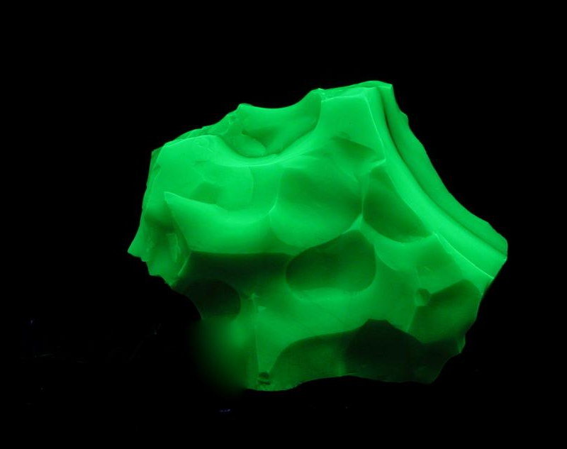
Collecting and Displaying
Fluorescent Minerals with an Opal Emphasis
By Jim Pisani
Editor
American Opal Society
Photo by Jan Wittenberg
President, FMS

Slide 2
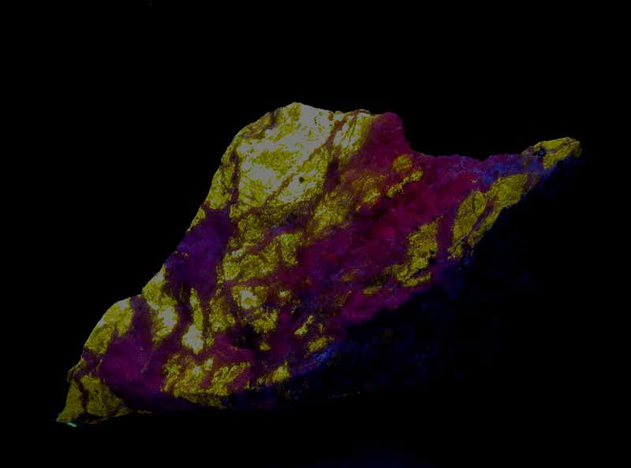
Outline
What is Fluorescence?
What is Ultraviolet Light?
Where Fluorescence used?
What are Fluorescent Minerals?
How do I collect them?
Where do I collect them?
Clubs, information
Demonstration of Fluorescence

Slide 3
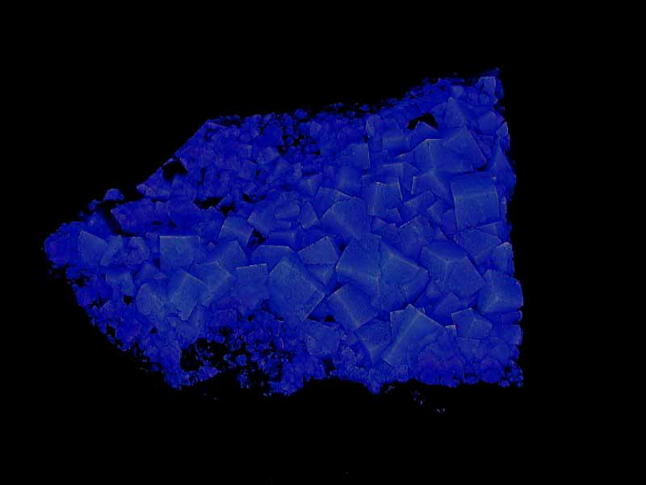
What is Fluorescence?
Fluorescence is the property of giving off light at a one emission wavelength (color) when illuminated by light of a different excitation wavelength (color).
  Excitation source can be a variety of wavelengths – e.g. - blue light, infrared light, ultraviolet light (typical).
  Emission wavelength can be many different ones, but always lower than the excitation wavelength
Phosphorescence is where energy is absorbed by a substance is released slowly in the form of light.
  This is used for "glow-in-the-dark" materials which are "charged" by exposure to light.
  Absorbed radiation may be re-emitted at a lower intensity for up to several hours

Slide 4
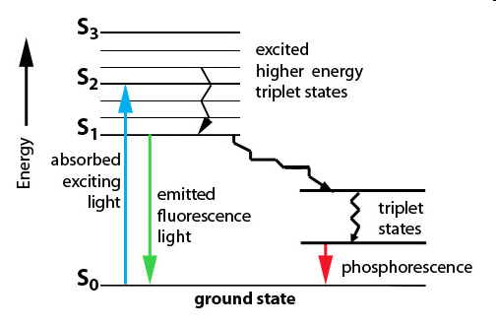
Fluorescent is a subatomic change of states
  Fluorescence occurs when a molecule, atom or nanostructure relaxes to its ground state (lower energy) after being electrically excited.

Slide 5
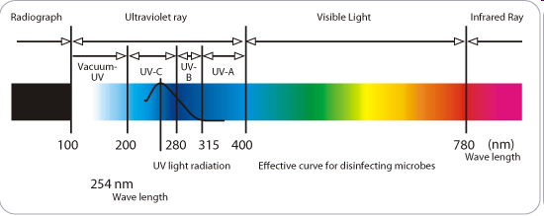
The Ultraviolet Spectrum

Slide 6
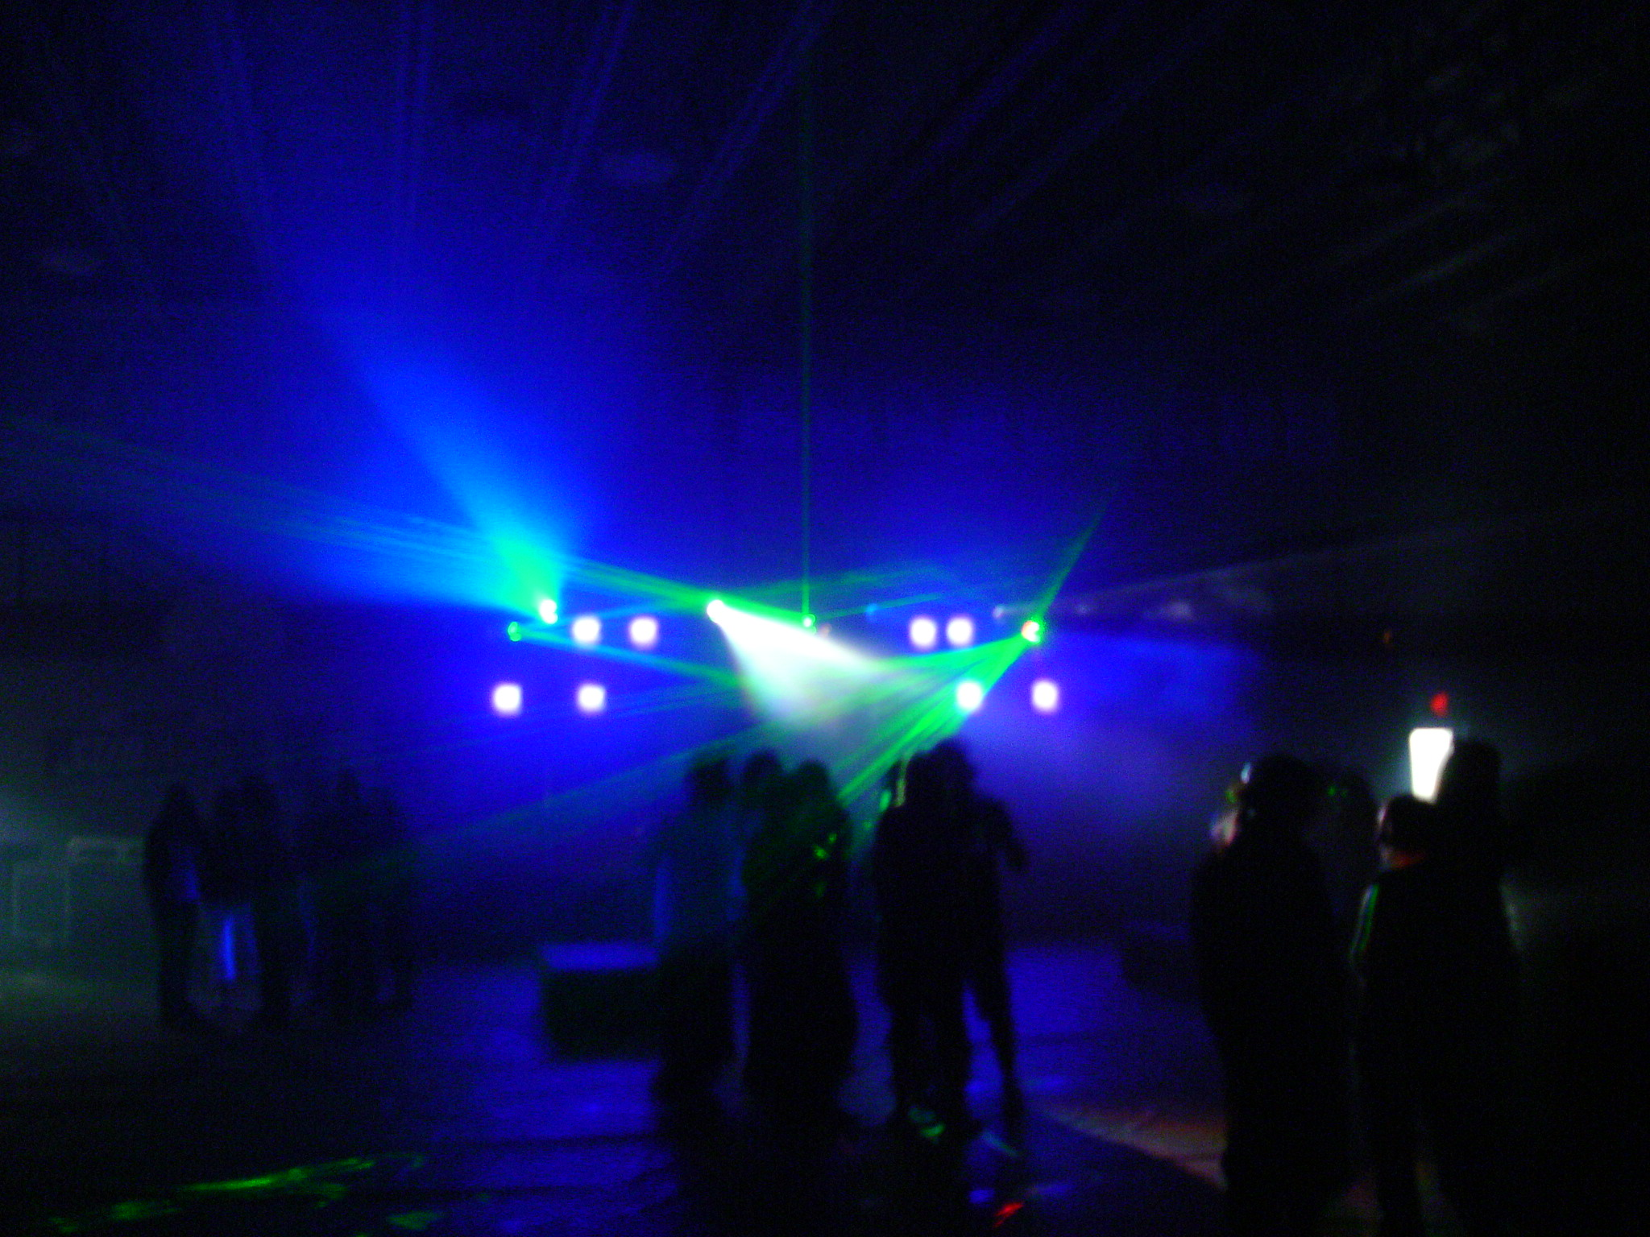
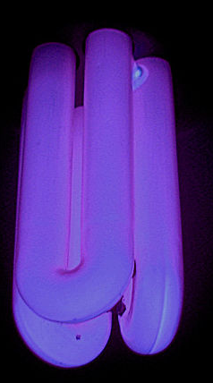
What is Ultraviolet Light?
High energy light at a wavelength outside of visible spectrum
Types of ultraviolet
  Long Wave (UVA)
    Present in Sunlight
    Typical “black light” seen in Disco’s, etc.

Slide 7
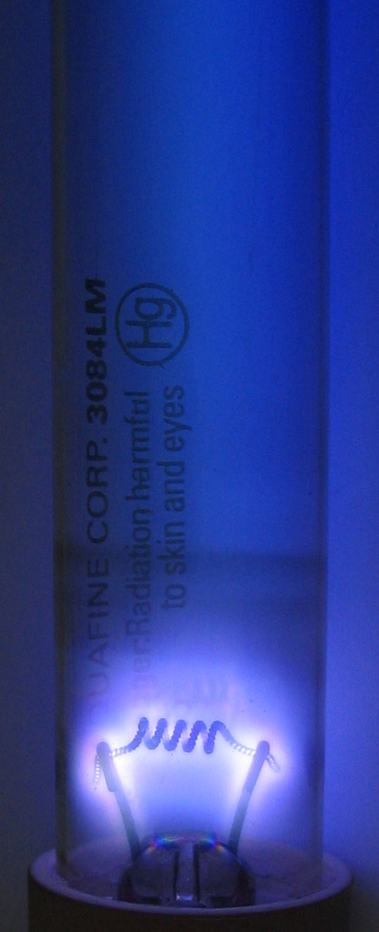
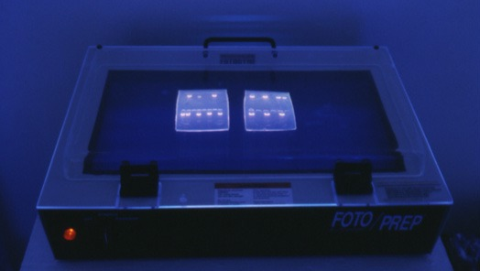
What is Ultraviolet Light?
Short Wave (UVC)
    Not present in Sunlight
    Most energetic fluorescent
Medium Wave (UVB)
    Present in Sunlight
    Least fluorescent wavelength
    Used in DNA Analysis

Slide 8
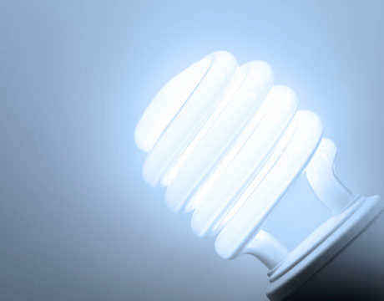

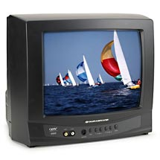
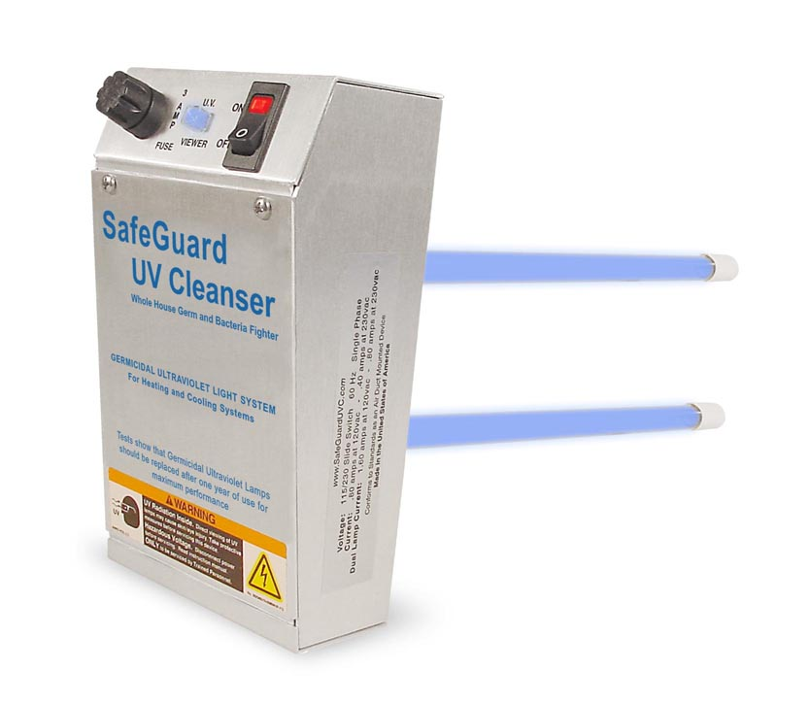
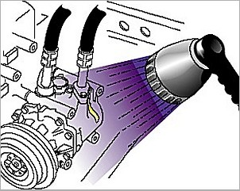

Where is Fluorescence used?
Fluorescent Lighting
White LED lights
TV’s (tube types)
Germicidal
Leak detection
Erasing EEPROMs

Slide 9
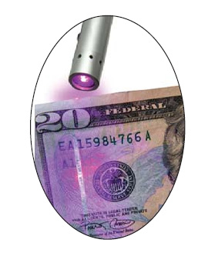
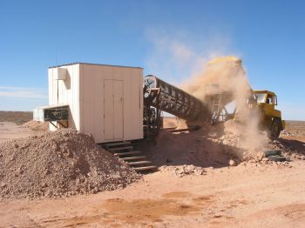
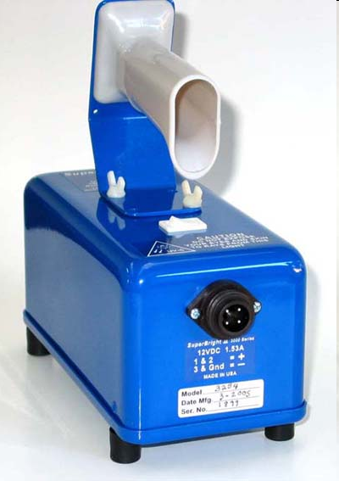
Where is Fluorescence used
Cure epoxy, paint, etc.
Readmission Control
Laundry detergent
forensic investigation
Medicine - Cellular imaging, DNA analysis, etc.
Counterfeit currency detection
Gems & Mineral
  Prospecting for various minerals
    e.g. scheelite (ore of tungsten, opal)
  “Noodling” for opal
  Collecting and Display cases

Slide 10
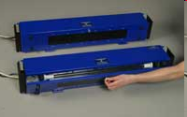
UV Lamps
Lamp Uses
  Permanent (Display)
    Large, require lots of power, but can have lots of UV light
    Main use in display cases, disco’s, etc.
  Prospecting (portable)
    Small, portable, light weight, for prospecting in “the bush”

Slide 11
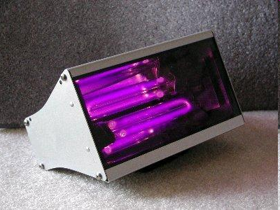
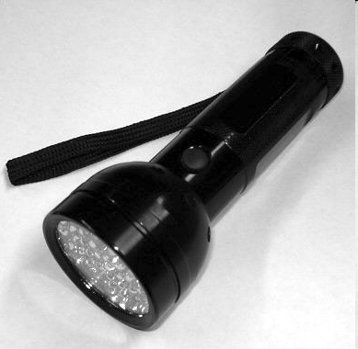
UV Lamps
Lamp Types
  Fluorescent tubes
    By far the most common
    Advantages – powerful, available at short, medium and long wavelengths
    Disadvantages - Bulky, power use, expensive
  UV LED Flashlights
    Advantages – light weight, inexpensive
    Disadvantages – low power, availability at shorter wavelengths at a reasonable price
    However, getting more powerful and cheaper

Slide 12
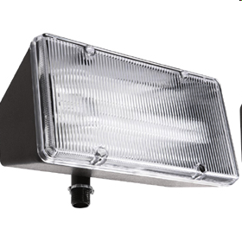
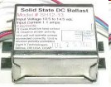
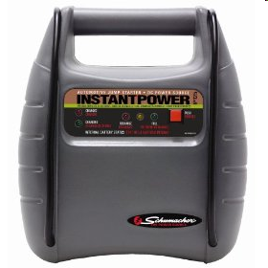
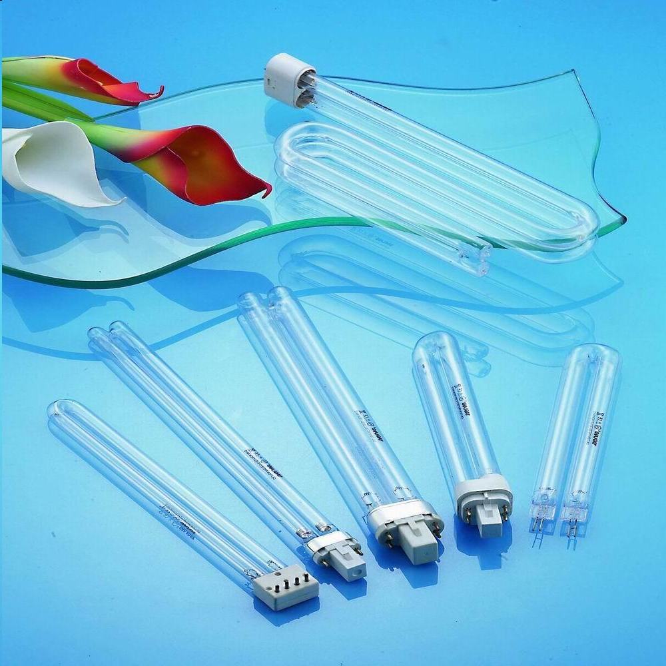

Build your own Portable UV Lamp
Cheaper for portable lamps
Most expensive component - Hoya U-325C Filter
Short wave UV bulb - can use a germicidal lamp
Long wave, UV bulb - available from a number of manufacturers
Plans: see Fluorescent Mineral Yahoo Group
Need Electronic Ballast
Need large battery
  Carry in backpack
CLF Spotlight Case
  Reflector can be important

Slide 13
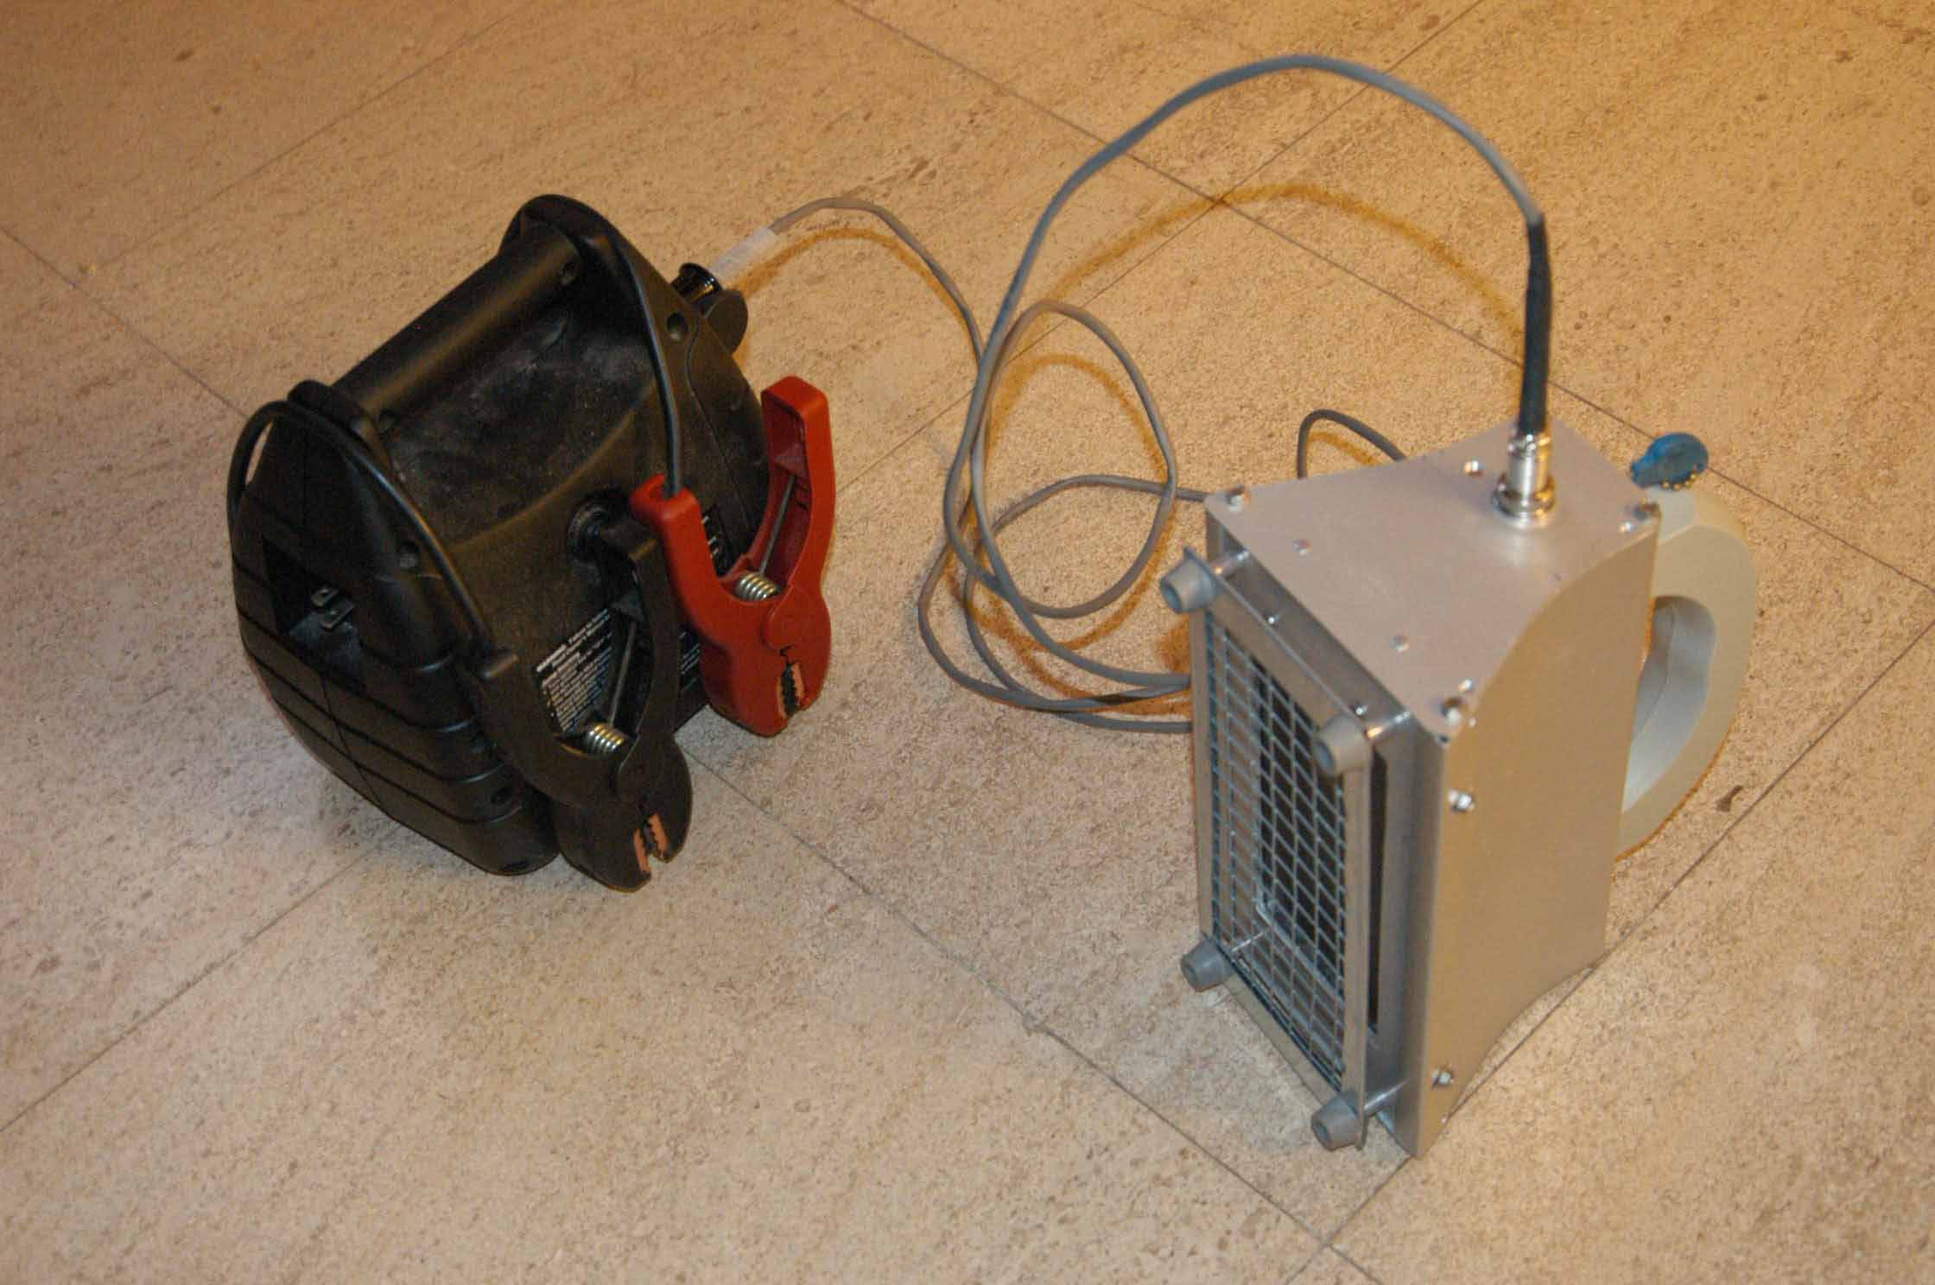
Homemade Portable UV Lamp – Version 1

Slide 14
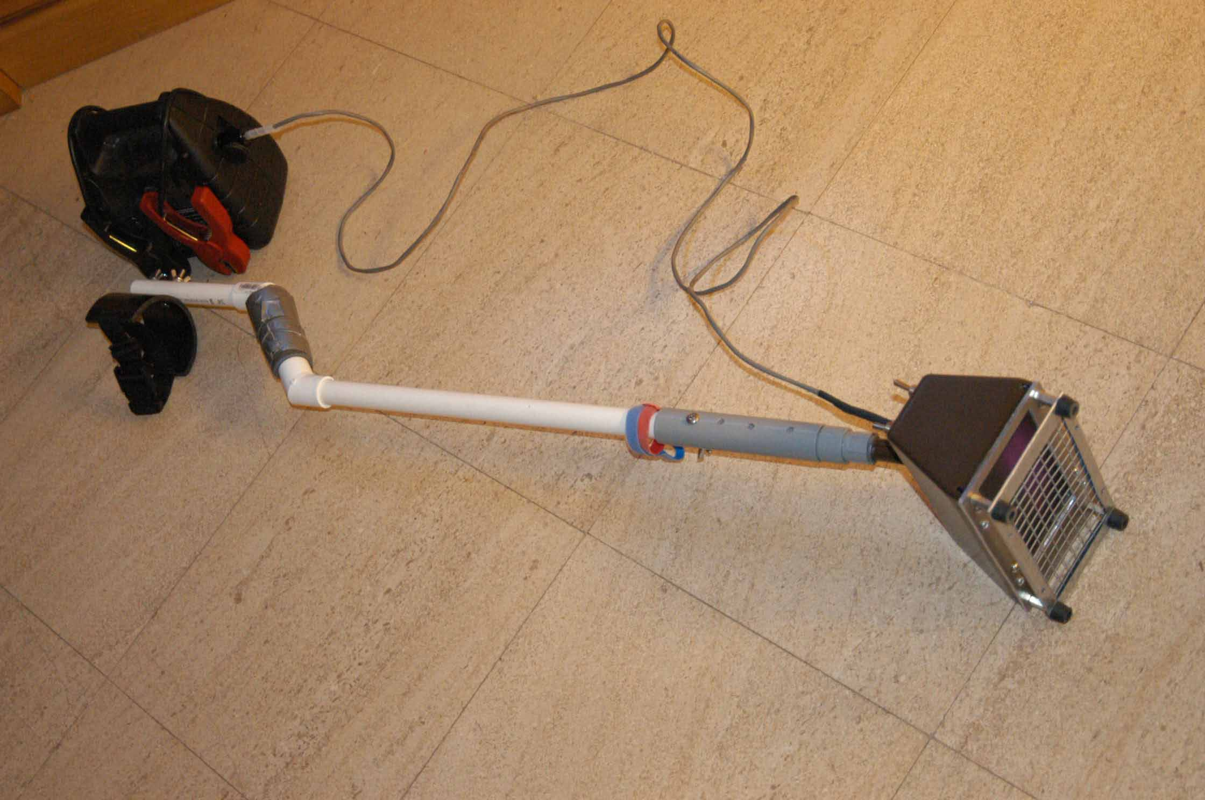
Homemade Portable UV Lamp – Version 2

Slide 15

Homemade Portable UV Lamp – Version 3
Most Inexpensive option - 12 volt portable CFL lamp
  Bayco SL-912T
  http://www.baycoproducts.com
  Almost everything is there
    Replace lights with UV bulbs
    Remove plastic cover and glue filter onto cover
    Contains own electronic ballast
  Disadvantages – reflector non-optimal

Slide 16
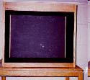
Display Cabinets
Usually a homemade affair
Lamps on top hidden from view
  Construct in such a way to vent heat
Glass or plastic (Lexan) can be used to shield viewers from Ultraviolet light
  Lexan is best
    prevents UV from lighting up surroundings, distracting from the specimens
  Glass will have a glowing side and a non-glowing side
    make sure glowing side is the external side
Line inside with black felt
Can be shortwave, longwave, or both

Slide 17
Typical Minerals that Fluoresce
Willemite
Fluorite
Sodalite
Wernerite
Calcite
Opal
Scheelite
Minerals may react to long wave differently than short wave
  Different intensities
  Different colors
  Short wave fluorescence is usually more energetic

Slide 18
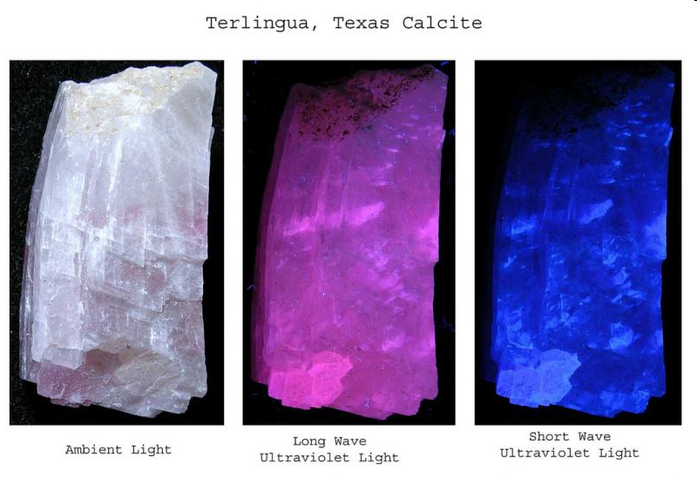
Different responses to different wavelengths
Photo by HP Garland
FMS

Slide 19

Where can I get Fluorescent Minerals?
Buy on eBay
  http://shop.ebay.com/i.html?_nkw=fluorescent+minerals&_sacat=0&_trksid=p3286.m270.l1313&_dmd=1&_odkw=%28minelab%2CF1A4%2Cfaceter%2Cfaceting%2Cfacetor%29&_osacat=0
Buy at Gem & Mineral Shows
  To find shows near you, go to: http://www.rockngem.com/showdates.asp
Trade with other collectors
Collect your own

Slide 20
Where can I collect Fluorescent Minerals?
Many areas contain local fluorescent minerals, but here are some of the famous ones
  Franklin, New Jersey
  Mount Saint-Hilaire, Quebec, Canada
  Arizona, Nevada, & California
    Purple Passion Mine, Wickenburg, Arizona
    Virgin Valley, Nevada
  The Ilimaussaq Complex, South Greenland

Slide 21
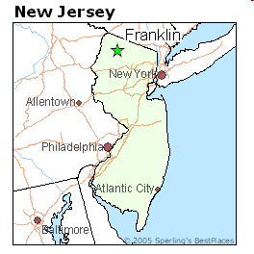
Franklin, New Jersey
The location of a large complex zinc deposit and mined since the 18th century, contains some of the most complex silicates in the world
Mines are now closed by plenty of dumps for digging
Unique Chemistry has made some of the minerals the most fluorescent in the world
Willemite, calcite, hardystonite, etc.
Many minerals are found no where else in the world

Slide 22
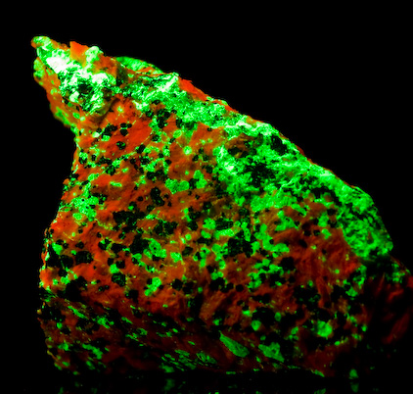
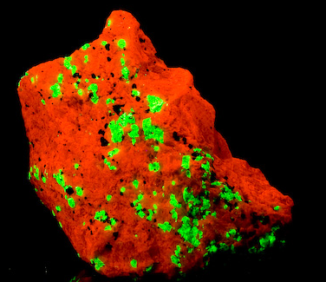
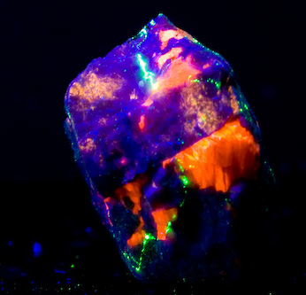
Typical Franklin Fluorescent Minerals
Nice 4-color: willemite, calcite, clenohedrite and hardstonite
Calcite and Willemite
Willemite and Calcite

Slide 23
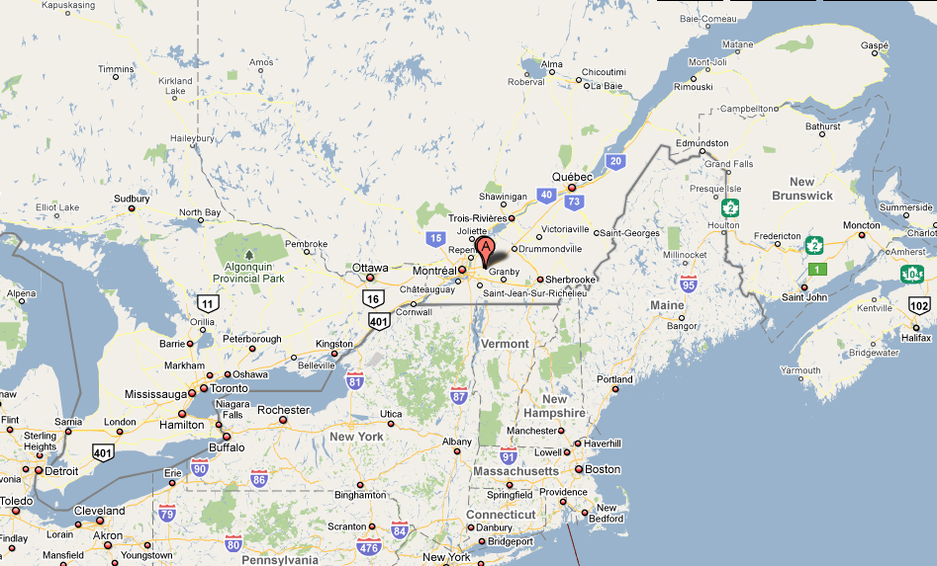
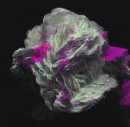
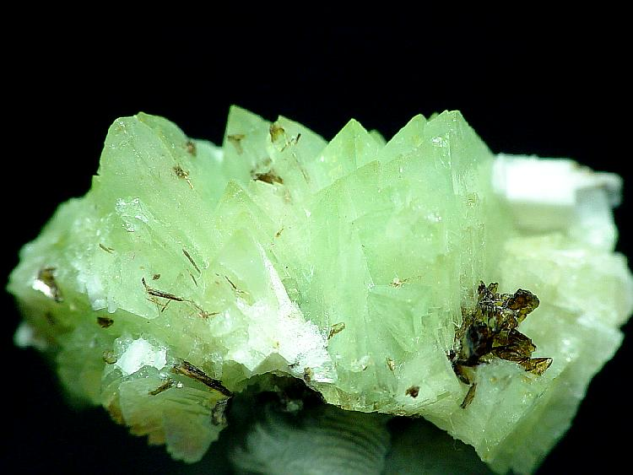
Mount Saint-Hilaire, Quebec, Canada
Alkaline intrusion complex – very rare geologically
Over 51 fluorescent minerals found at this location
Sodalite, Albite, Apatite, Polylithionite etc.
Polylithionite and albite under SW
Genthelvite crystals under SW

Slide 24
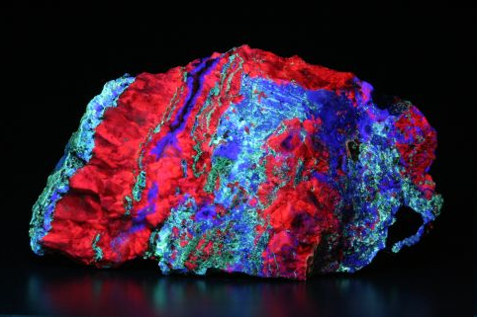
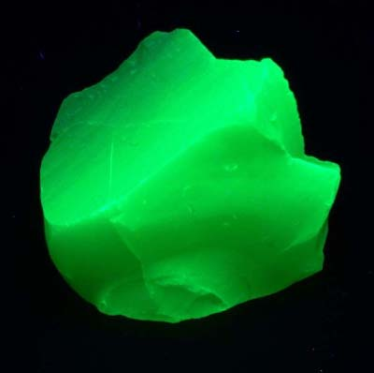
Arizona, California & Nevada
Willemite, Calcite, Fluorite, Aragonite, from the Purple Passion Mine, Wickenburg, Arizona
Common opal, from Virgin Valley, Nevada

Slide 25
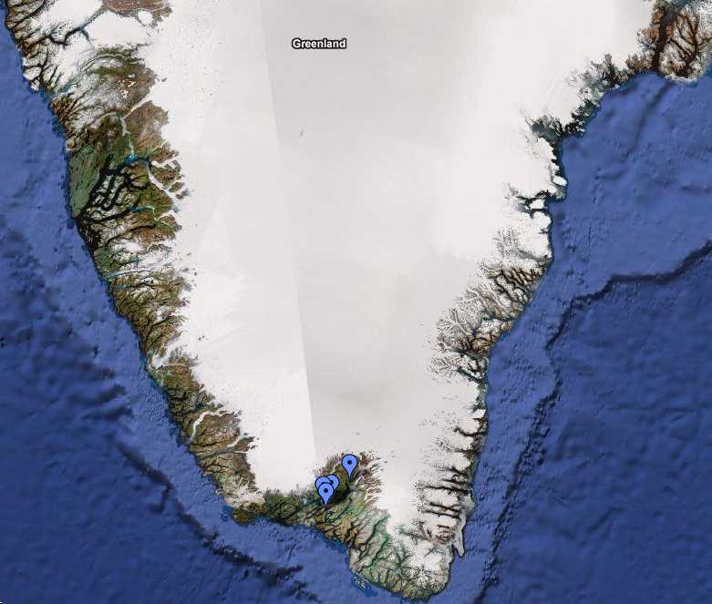
The Ilimaussaq Complex
The Ilimaussaq Complex is a unique geological intrusion in an area of Southern Greenland that is free of ice
Near the town of Narsaq
The Tunulliarfik and Kangerluarsuk Fjords cuts through the middle of the Ilimaussaq Complex
Some of the most unusual minerals in the world can be found here
  Gem quality ussingite
  massive veins of sodalite, including tenebrescent green sodalite
  brilliant assortments of multi-color tugtupite
  deeply tenebrescent green sodalite

Slide 26
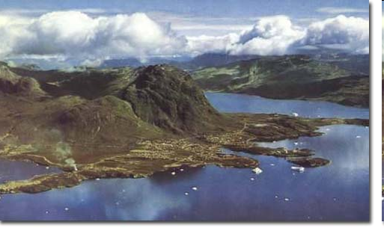
The Ilimaussaq Complex

Slide 27
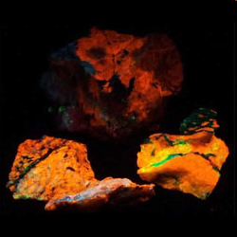
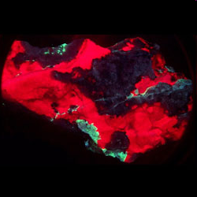
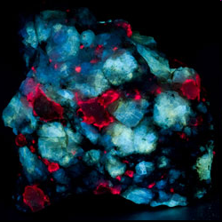
Greenland Fluorescent Minerals
Yellow Sodalite
Tugtupite
Analcime

Slide 28
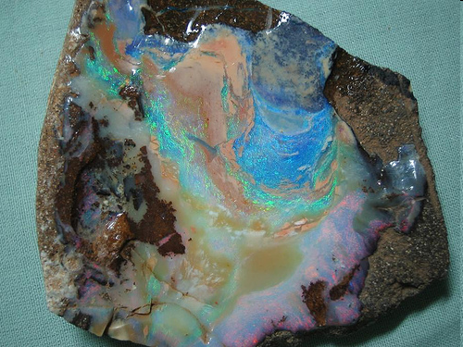
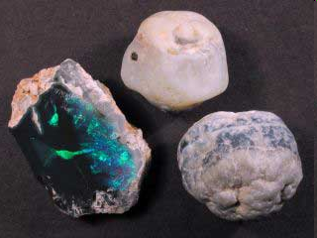
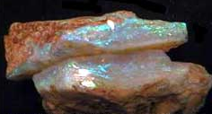
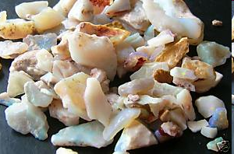
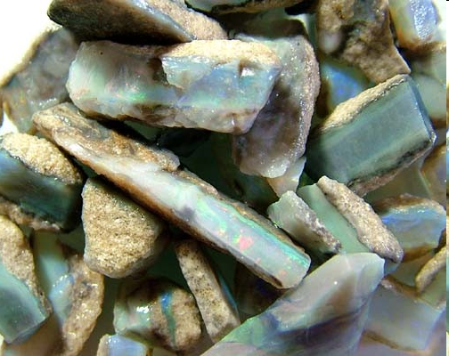
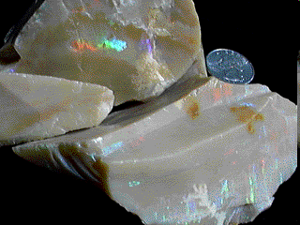
Opals and Fluorescence Australian Opal
Most Australian Opal will fluoresce better to long wave than short wave
Most boulder opal does not fluoresce
Some Lightning Ridge opal will fluoresce white
Some Andamooka opal and opal matrix will fluoresce white
Most Coober Pedy opal will fluoresce white
Most Mintabe opal will fluoresce white
Most Lambina opal will fluoresce white

Slide 29
Opals and Fluorescence
American Opal
Most American Opal will fluoresce bright green
Tecopa Opal will fluoresce more strongly to short wave
Hyalite opal some of the brightest fluorescent minerals
Virgin Valley Common opal – very bright – high concentrations of uranium
  Precious opal does not
Wyoming common opal – very bright green and orange
Spencer opal – weak white response to SW and LW
Ice cream opal – strong green rsponse to SW, LW

Slide 30
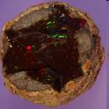
Other Opal
Ethiopian opal does not fluoresce
Brazilian opal – some, mild LW, some, Strong green SW
Peruvian opal - ?
Whitesail opal - no fluorescence
Mexican Opal – no fluorescence

Slide 31
What Causes Minerals to Fluoresce?
Pure minerals usually do not fluoresce
  Exceptions – Scheelite, powellite, cerussite
Activators – trace elements that enable fluorescence
  Manganese, lead, uranium, rare-earth elements, especially europium
Quenchers – their presence can stop fluorescence
  cobalt, and nickel, and to a lesser extent, copper

Slide 32
A word on Safety…
Ultraviolet light can be dangerous
  Long wave is safe (e.g. Black Light in Disco’s)
  Medium wave and short wave ultraviolet light can burn the skin and eyes and increase risk of skin cancer
    Damage is based on exposure time
  ALWAYS use eye and skin protection with medium and short wave ultraviolet light
    Shortwave ultraviolet is almost completely stopped by most forms of glass or plastic.
  ALWAYS avoid staring directly at a UV light source

Slide 33
UV Demonstration
If you wish to participate, please wear glasses or the plastic frames provided and do not stare into directly the UV light
Various minerals on display
  Opal from Australia, America’s
  Franklin calcite and willemite
    Bright red and very bright green under SW
  Tugtupite from Greenland
    Orange under LW and red under SW
    Exhibits tenebrescent – the ability of UV to semi-permanently change the actual color of the mineral
  Wernerite from Canada
    Bright yellow under LW
  Misc

Slide 34
The End

Slide 35
Backup Slides

Slide 36
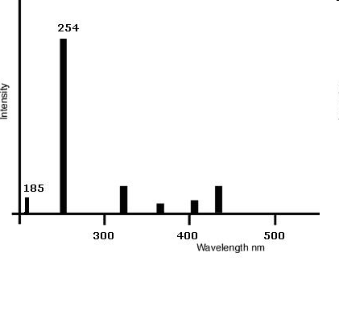
Germicidal Low Pressure Mercury Lamp Spectrum
Most of the energy is at 254 nm, right in the middle of UVC band
Some other energy in UVA and violet spectrum
Requires visible blocking filter to block violet light, which would overshadow the fluorescence

Slide 37
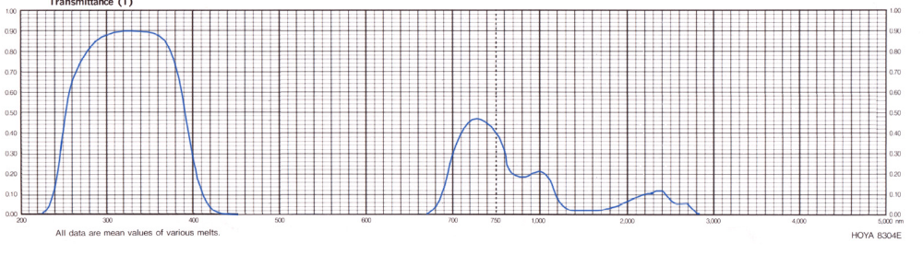
Ultraviolet Transmitting, Visible Absorbing Filter
Hoya U-325C Filter
Spectrum cuts off visible light
Expensive - $170 for 6” x 6” glass plate
  Cut in half for two lamps
  Have limited lifespan due to “solarization”

Slide 38
Germicidal Low Pressure Mercury Lamps
Designed to kill microbes in AC’s wands, etc.
Germicidal – kills bacteria, viruses, dust mites, etc.
Clear, no phosphors
Made out of quartz, not glass

Slide 39

UV Lamps
Where to get them?
Purchase new
  Retail Brands – most carry portable and display
    Superbright II - http://uvsystems.com
    Way Too Cool lamps - http://www.fluorescents.com/uv.html
    Ultraviolet Lighting Products “Ultralight 2002” - http://uvlp.com
    LED Lamps - http://www.polmanminerals.com/html/uv_led_flashlight.html
      I added a “Woods Glass” filter to black out the visible light (photo stores carry them)
    Spectroline - http://www.spectroline.com
    Cole Parmer - http://www.coleparmer.com
Purchase used
  eBay Internet Auctions – http://eBay.com
    Surprisingly cheap for surplus scientific equipment
      Large Display lamps
      Transilluminators (used for DNA research)
        Can salvage the filter from them
        Usually medium wave
  Gem & mineral shows, Want ads

Slide 40


Clubs, Information
Fluorescence Mineral Society
  World wide organization
  Large Local Southern California chapter
  http://uvminerals.org
Fluorescent Mineral Yahoo! Group – Online Blog
  http://groups.yahoo.com/group/Fluorescentminerals/messages
American Opal Society
  http://opalsociety.org
Recommended Books:
  The World of Fluorescent Minerals, by Stuart Schneider
  Collecting Fluorescent Minerals, by Stuart Schneider

